Slide 1
Grabcut user manual
Qian Zhang
qzhang348@wisc.edu

Slide 2
User manual
1 Install python (version 2)
2 Install opencv
3 execute the code in command line “python grabcut.py filename” where filename is the name of the image file
4 Follow the instructions given in the prompt
5 Press Esc to exit the program
Examples are shown in the next slides

Slide 3
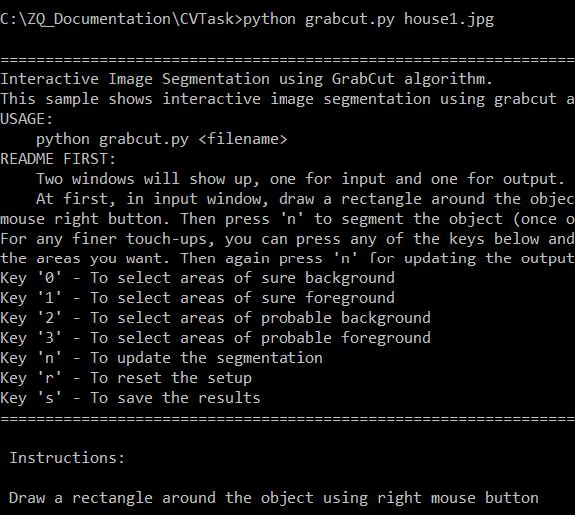
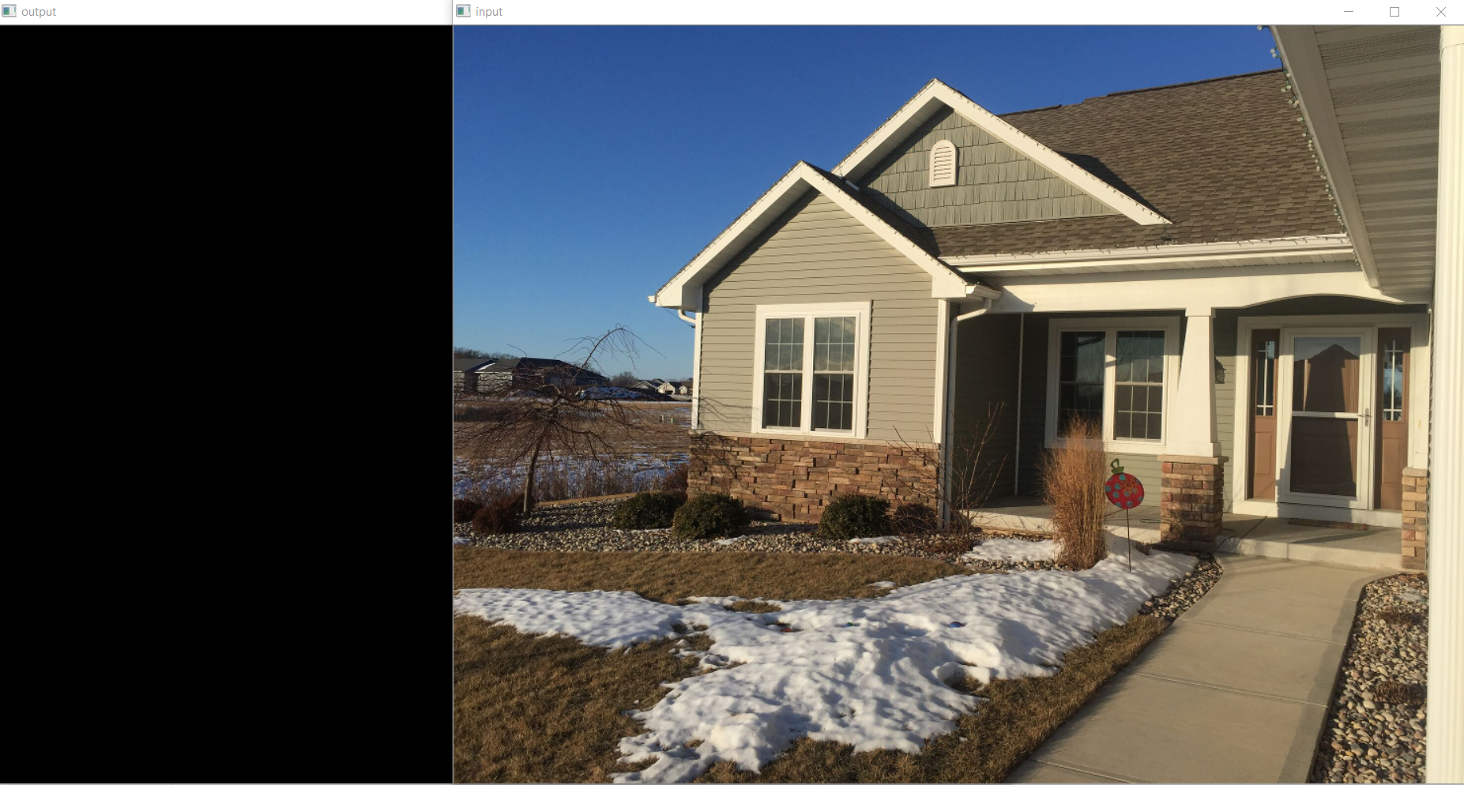
Example1:
1 Execute the code and you will get these 2 windows

Slide 4
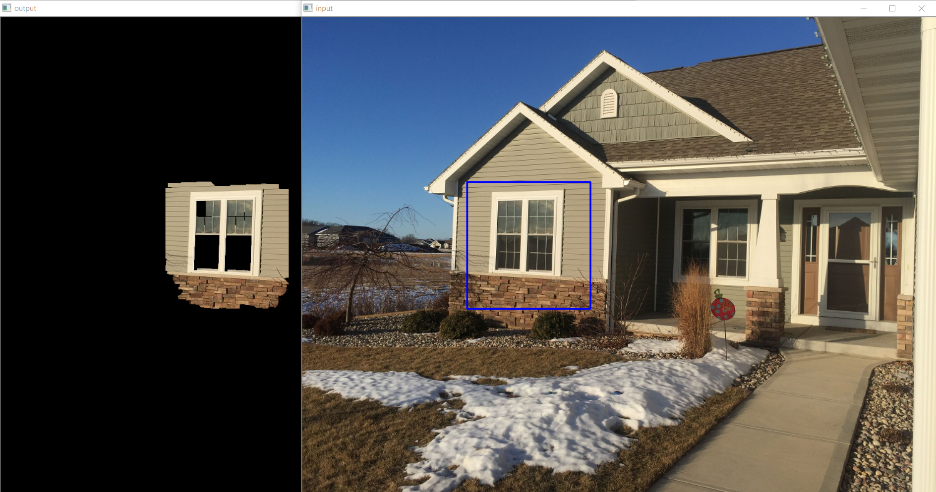
Example1:
2 Select the object you are interested in by draw a rectangle around it using right mouse button, and press n to update the result.
These parts don’t belong to the object but haven’t been removed
These parts belong to the object but have been removed

Slide 5
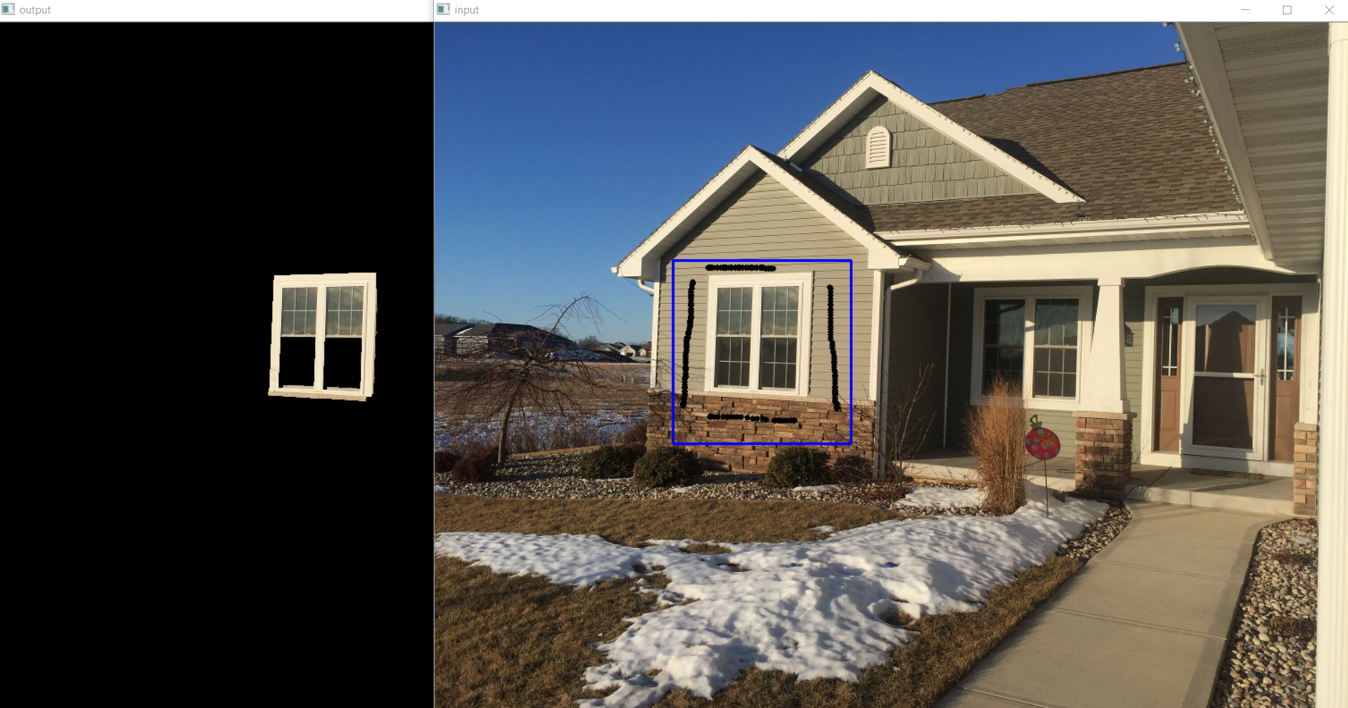
Example1:
3 Press 0 and use left mouse button to draw lines in background to remove background and press n to update the result.
These parts belong to the object but have been removed

Slide 6
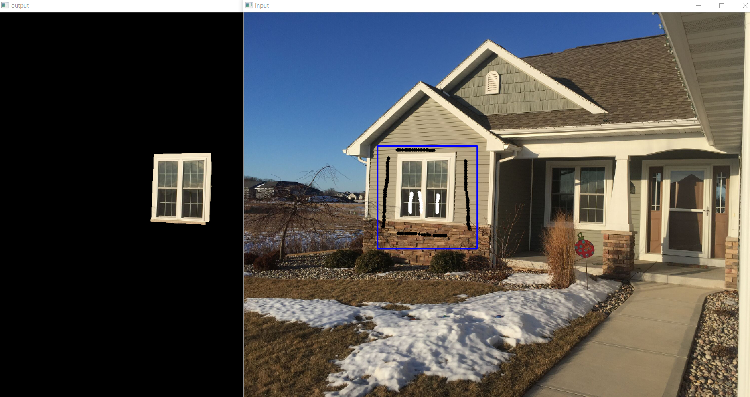
Example1:
4 Press 1 and use left mouse button to draw lines in foreground to restore removed foreground and press n to update the result.

Slide 7
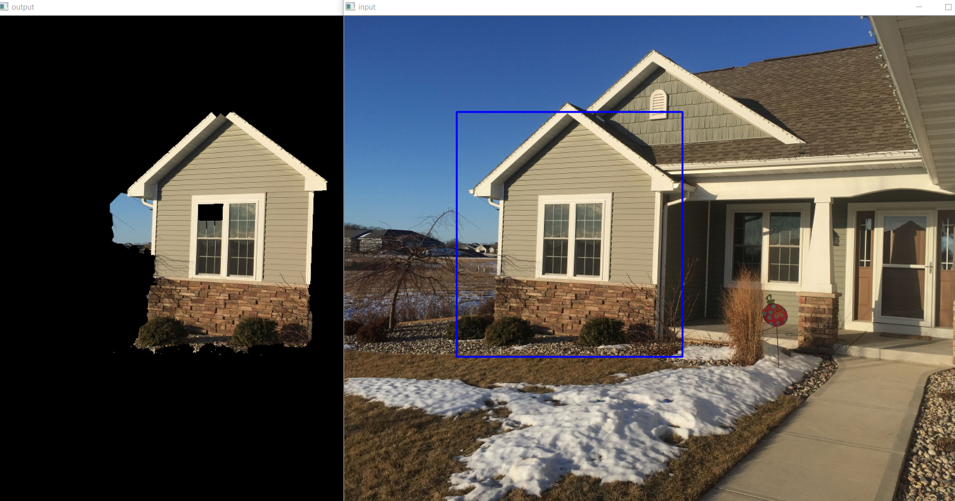
Example2:
The less accurate the rectangle is, the more indications for background and foreground are needed.
And the less homogeneous the background is, the more indications for background and foreground are needed.

Slide 8
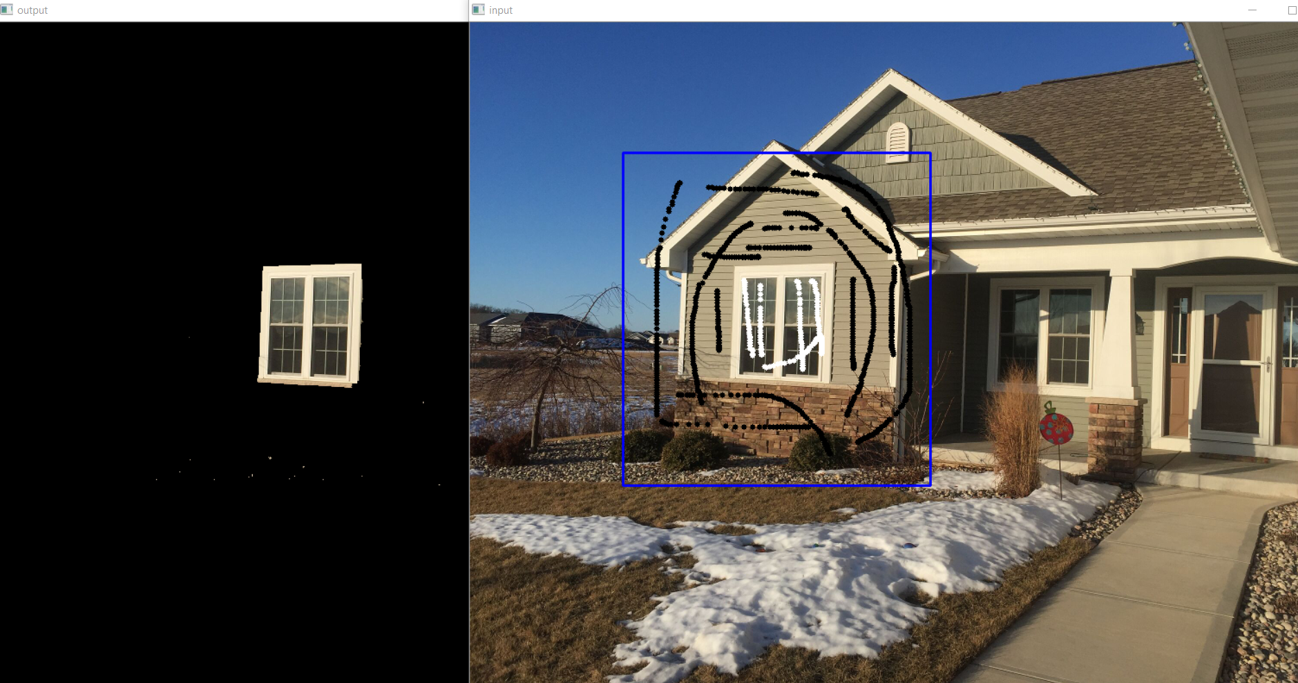
Example2:
And you can try to remove background and restore foreground iteratively, and press n to update the result in the output window and to see what the result looks like, and then decide if you need to do more indications.

